Slide 1
How Concerns About Food Safety are Viewed by Consumers
Sandra M. McCurdy, Ph.D.
Extension Food Safety Specialist
School of Family and Consumer Sciences
University of Idaho
April 11, 2008

Slide 2
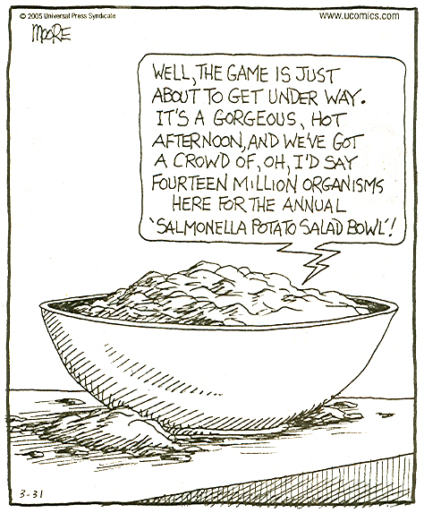
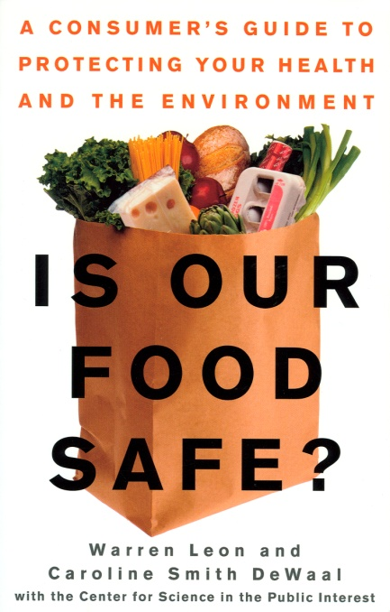

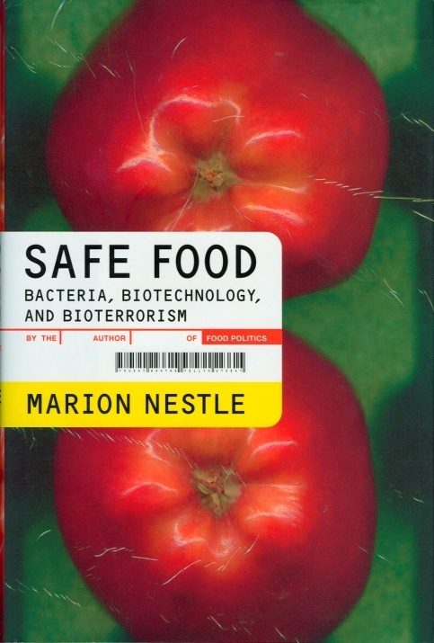
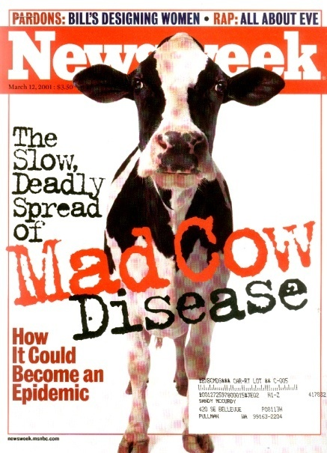
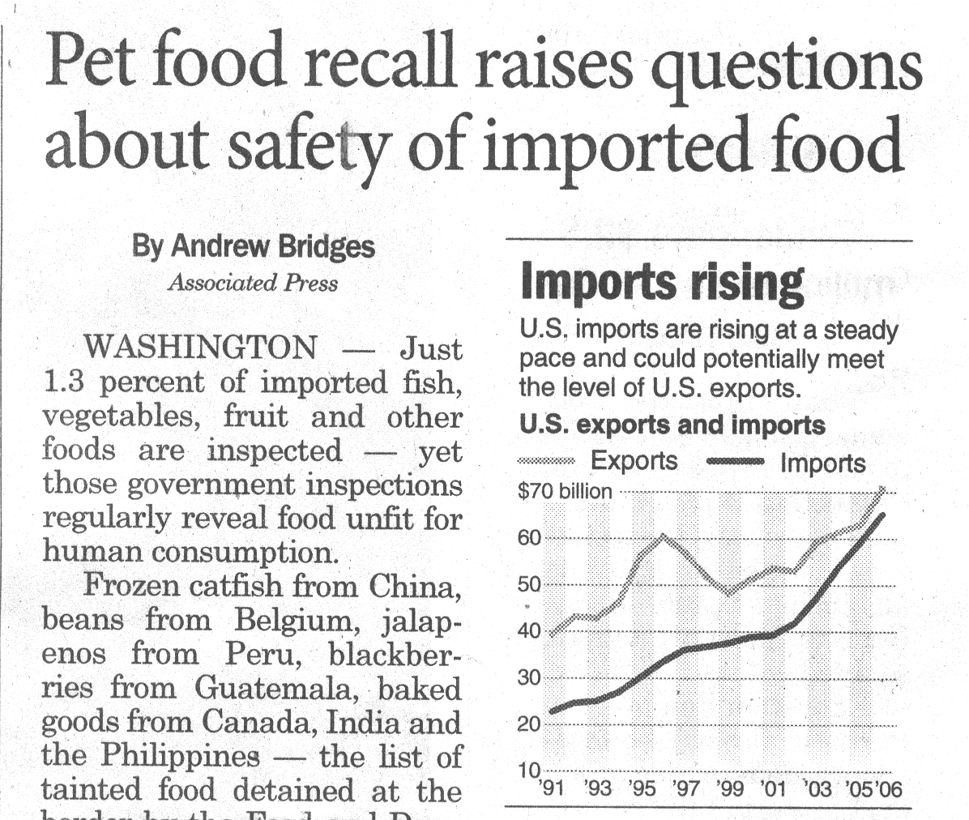
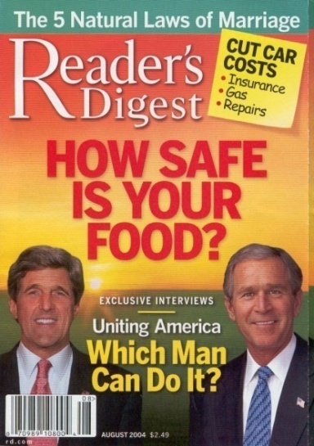
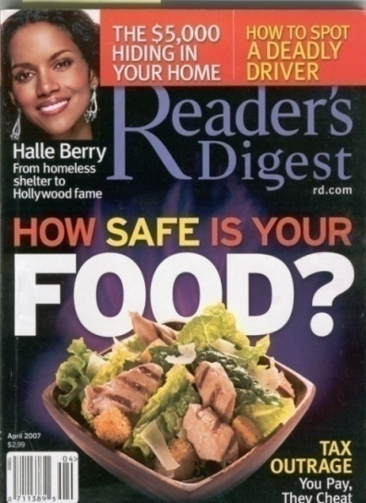
Food Safety is Important to Consumers

Slide 3
Topics…
1975-79 | 1
1980-84 | 1
1985-89 | 2
1990-94 | 11
1995-99 | 46
2000-02 | 27
Introduction:
  Consumer Reports 1937-1991¹
  Consumer food safety studies²
Survey data: What consumers think about the safety of food in the US
Consumer behavior change & needs: Some examples
¹Payson, S. 1994. “Using Historical Information to Identify Consumer Concerns about Food Safety,” USDA Tech Bull 1835.
²Redmond, E.C. and Griffith, C.J. 2003. “Consumer Food Handling in the Home: A Review of Food Safety Studies.” J. Food Protection 66:130.

Slide 4
Food Safety Policy Center Survey Telephone interviews, Nov 05 – Feb 06, 1014 participants
Harris, C., Knight, A., and Worosz, M. 2006. “Shopping for Food Safety and the Public Trust.” Food Safety Magazine, Jun-Jul, page 52-59.

Slide 5
Food Safety Policy Center Survey Telephone interviews, Nov 05 – Feb 06, 1014 participants

Slide 6
Food Safety Policy Center Survey Telephone interviews, Nov 05 – Feb 06, 1014 participants
As estimated 25% of the population will get sick because of consuming contaminated foods and beverages each year.

Slide 7
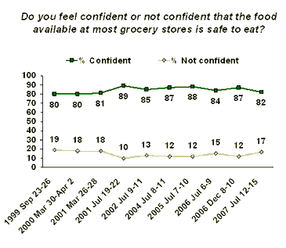
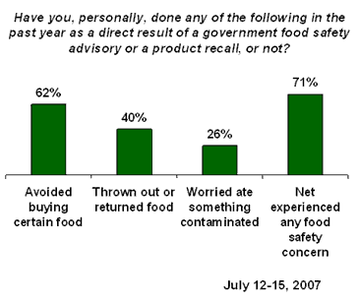
Industry Surveys
FMI Grocery Shopper Trends, Jan 2007
  Completely or somewhat confident in safety of supermarket food
Supermarket Guru Online, Apr 2007
Gallup Poll, Jul 2007
Year | %
2006 | 82%
2007 | 66%
 | %
100% safe | 0
Very safe, always some… | 14
Safe, could be better | 71
Not safe | 15

Slide 8
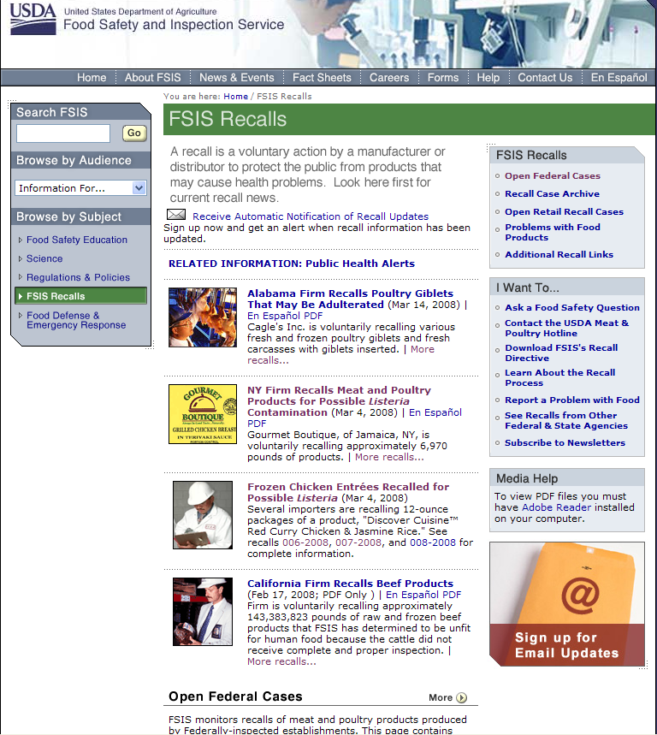
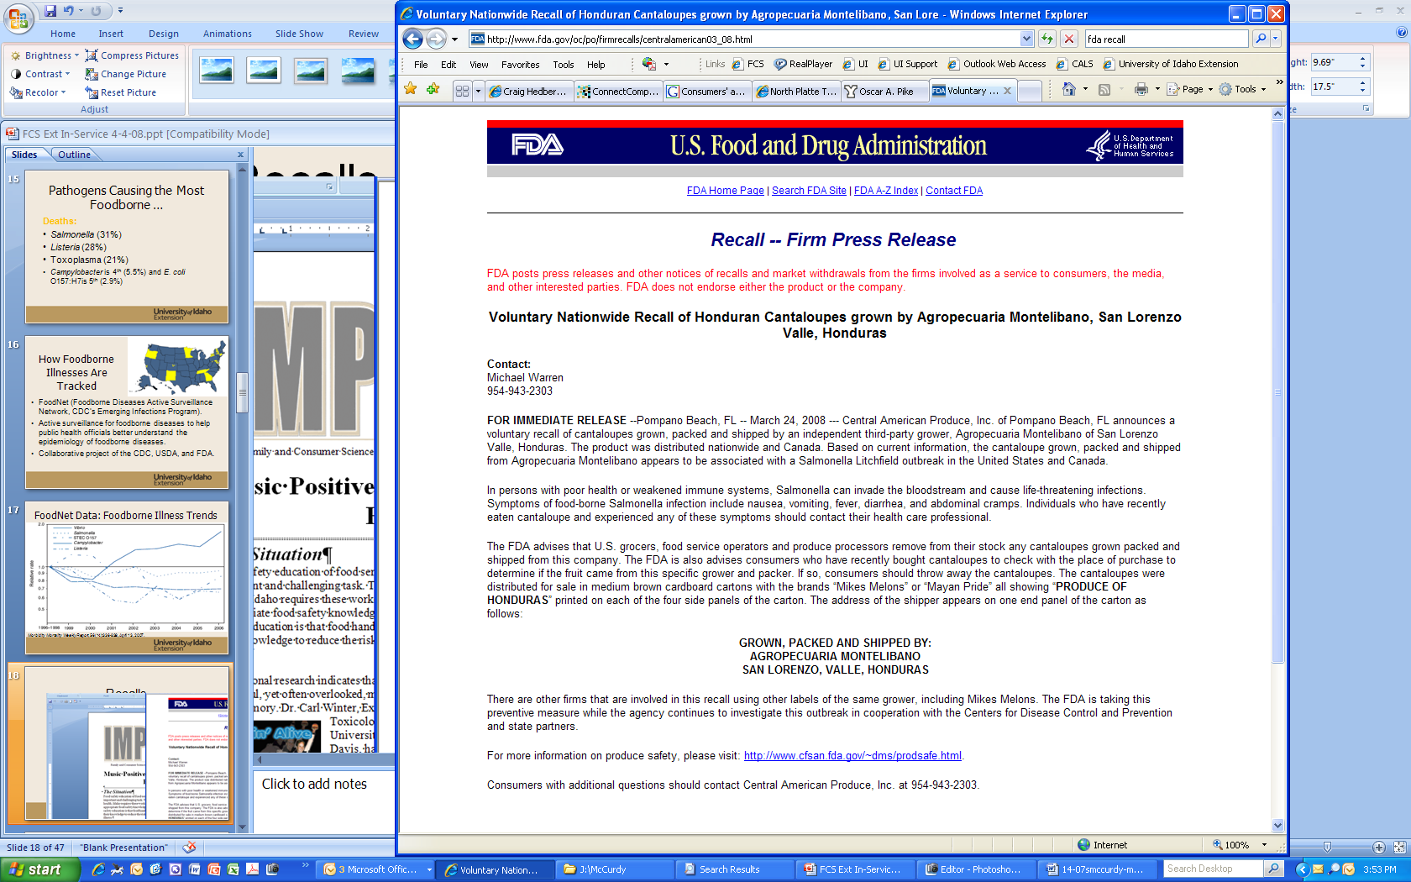
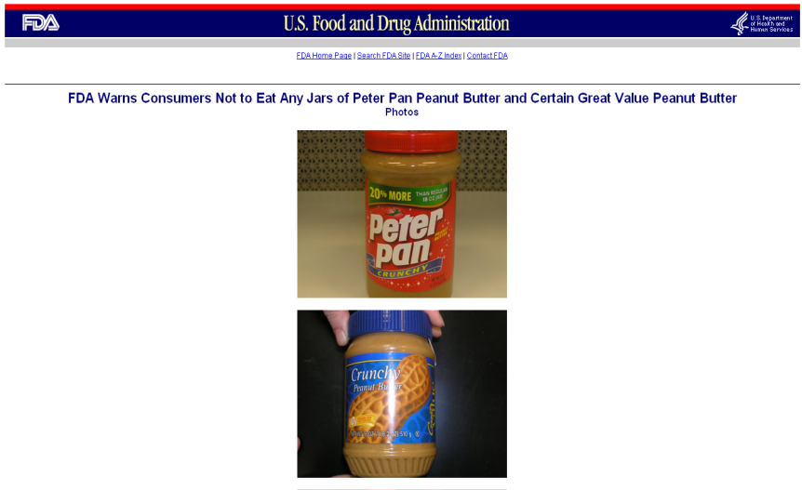
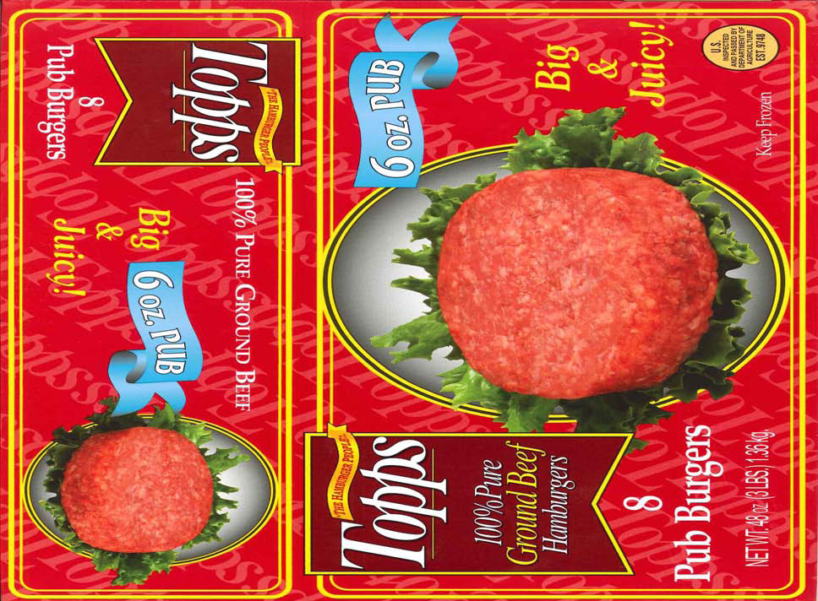
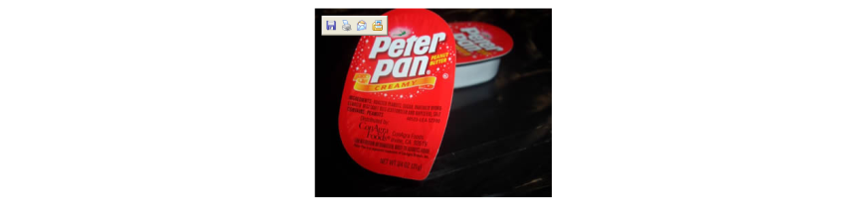
Recall Notifications

Slide 9
Recall Effectiveness
1998 Bil Mar recall of hot dogs & deli meats: 108 cases, 14 deaths, 3 miscarriages (phone survey of 633 persons)
45% knew about the recall; 70% found out via TV
2006 spinach outbreak: 205 illnesses, 3 deaths (phone survey of 1200)
87% heard that bagged fresh spinach had been contaminated and should not be eaten.
Patrick, M.E., Griffin, P.M., Voetsch, A.C. and Mead, P.S. Effectiveness of recall notification: Community response to a nationwide recall of hot dogs and deli meats. J. Food Protection 70(10):2373.
Cuite, C.L., Condry, S.C., Nucci, M.L. and Hallman, W.K. “Public response to the contaminated Spinach recall of 2006,” Rutgers University Food Policy Institute, 2-5-2007.

Slide 10
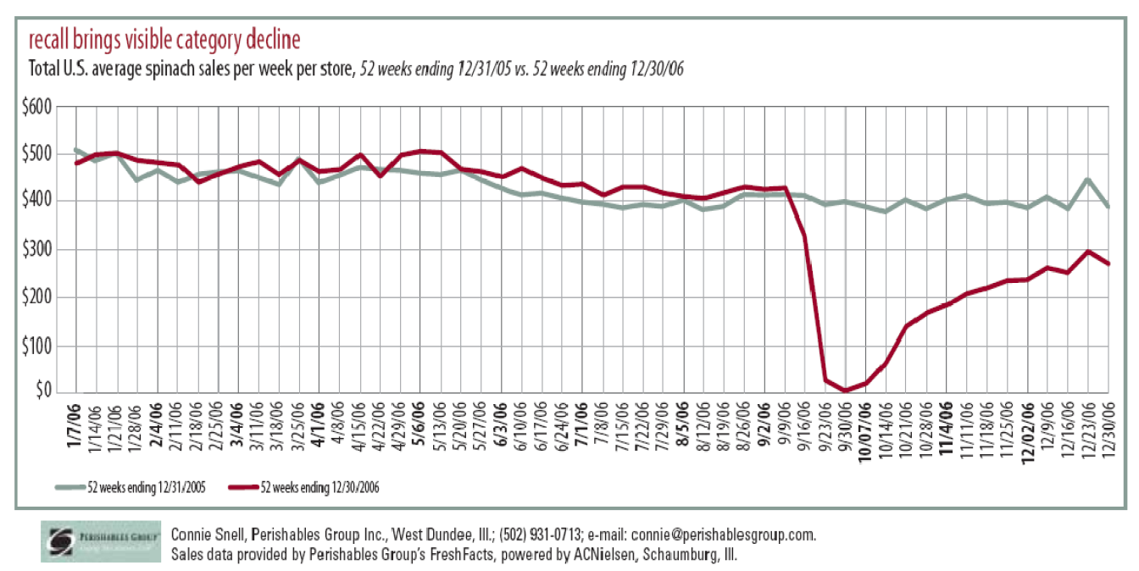
Consumers do pay attention
Spinach sales in 2005 & 2006
Hallman, W.K., Cuite, C.L., Nucci, M.L. Pleasant, A.F. Chess, C. 2008. “Examining the 2006 Spinach Crisis from Multiple Perspectives,” Food Policy Institute, New Jersey Ag Exp Station, http://www.foodpolicyinstitute.org/news/default.asp?id=9.

Slide 11
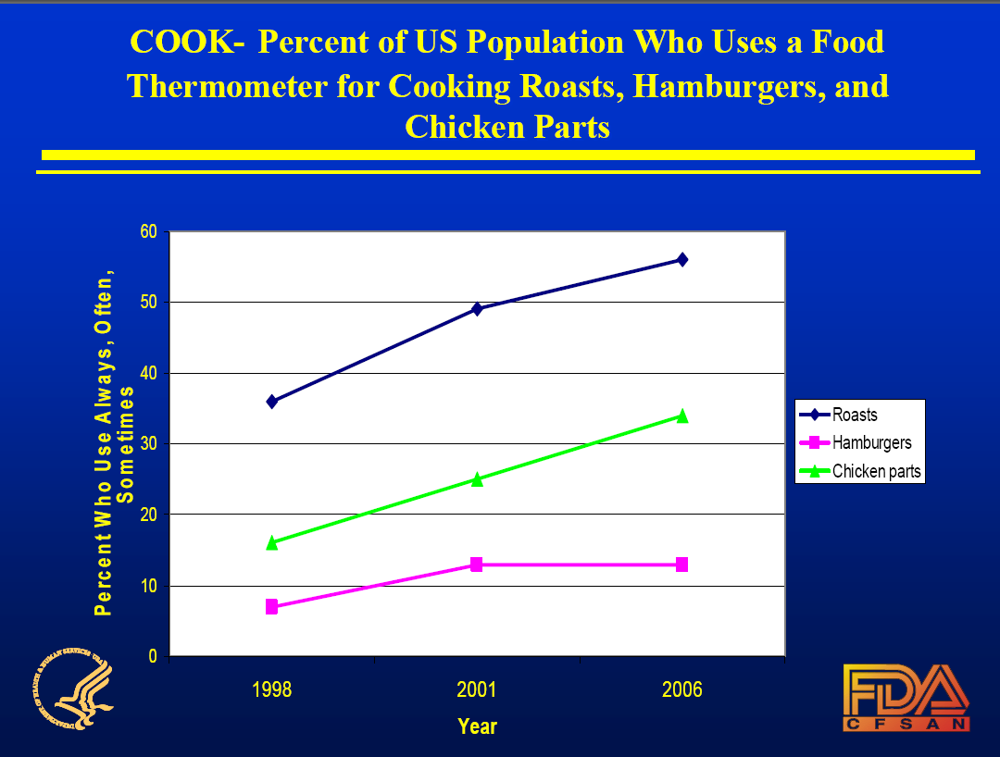
Consumer Behavior Does Improve

Slide 12
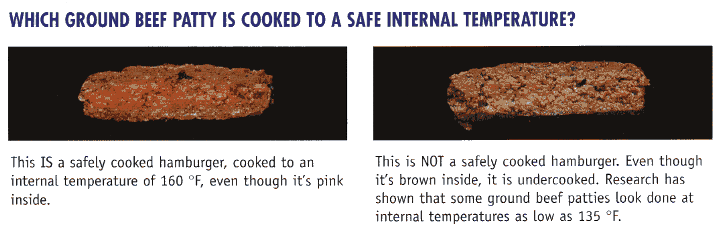
For ground beef patties, color is not an indicator of end-point temperature.
Safe: Has reached 160ºF
Unsafe: Has not reached 160ºF
Use an instant-read thermometer to assure doneness.

Slide 13
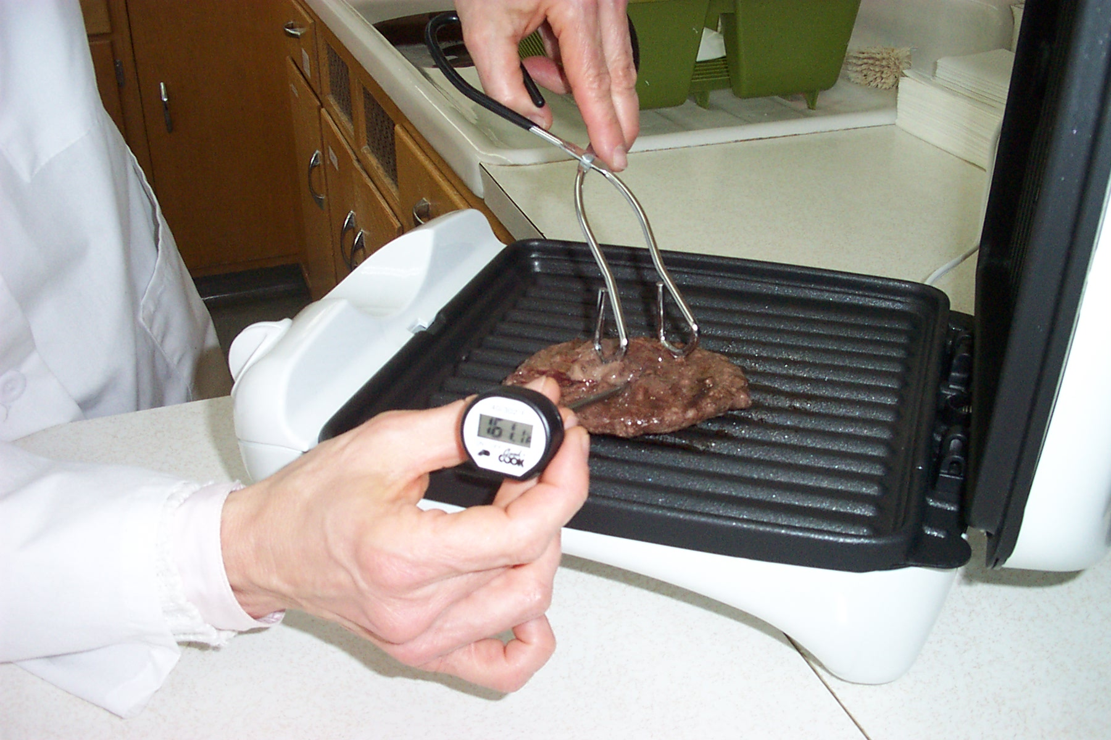
Instant-read food thermometers are used by only about 10% of consumers with ground beef patties.

Slide 14
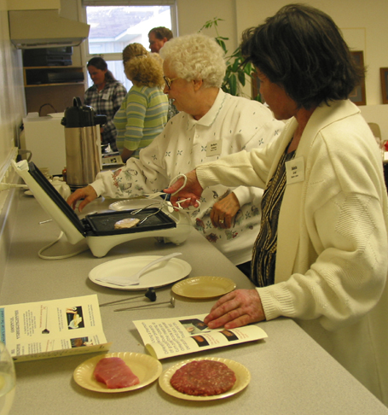
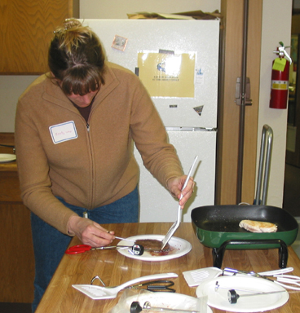
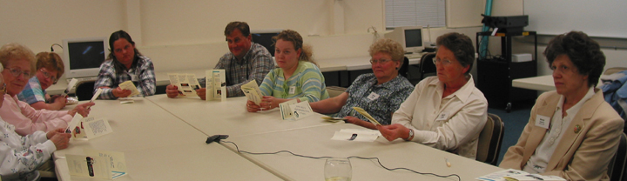
Focus groups to assess barriers to thermometer use

Slide 15
Selected group responses
What did you think about using a thermometer?
  “Felt good” to know meat was safely cooked.
What would keep you from using?
    Lack of time, forgetfulness and laziness.
    Inconvenient.
    Not comfortable using the thermometer.
What would motivate?
    Avoidance of foodborne illness, especially re children or elderly persons .
    Improved meat quality.

Slide 16
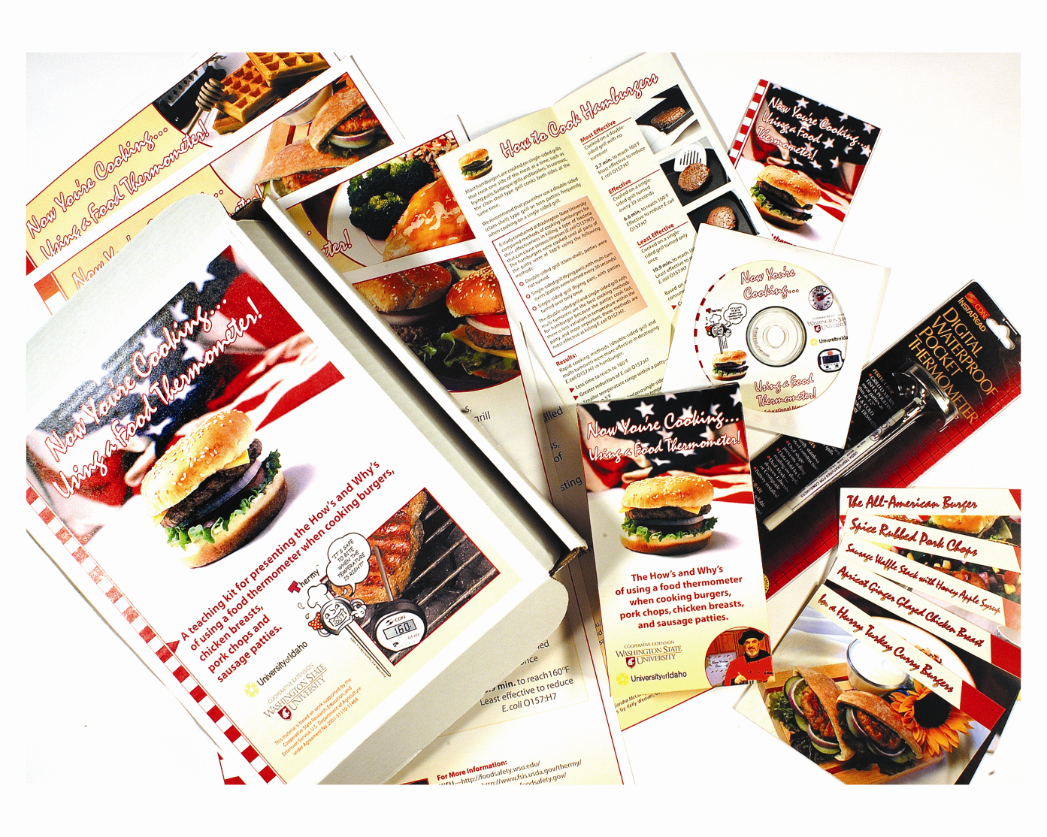
Develop educational/motivational materials
Now You’re Cooking…Using a Food Thermometer
Transtheoretical Model (Stages of Change) and the Health Belief Model used to develop:
Brochure
Recipe cards
Video
Curriculum kit

Slide 17
Did the materials work?
Consumer classification for Stage of Change for thermometer use Pre- Post-
Pre-contemplation 80% 46%
  Contemplation 8% 12%
  Preparation 3% 7%
  Action 1% 18%
  Maintenance 8% 16%
Consumer use of food thermometers for small cuts of meat
  Never use 85% 48%
  Regularly use 4% 16%

Slide 18
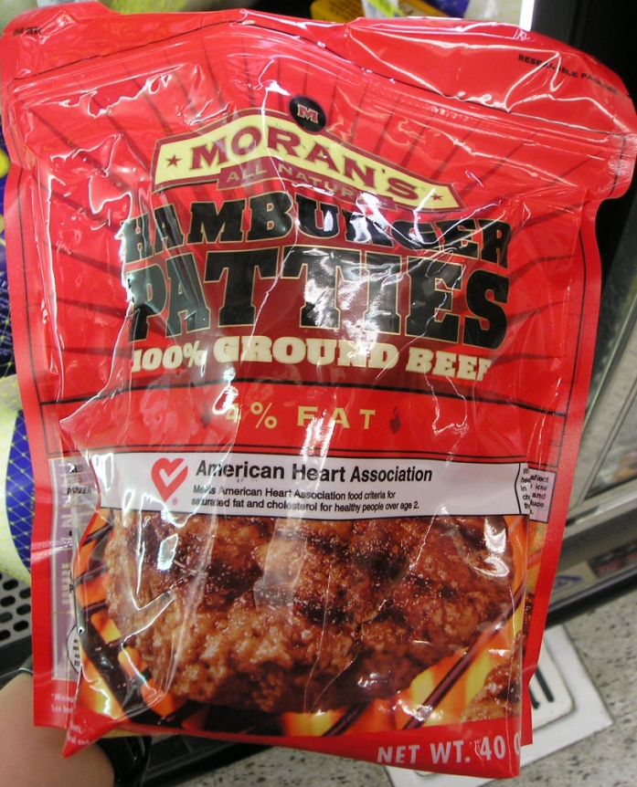
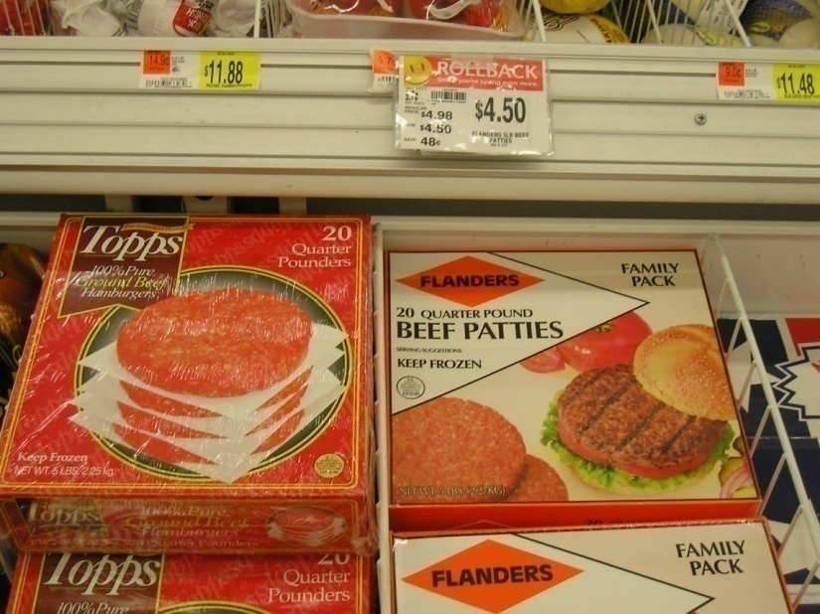
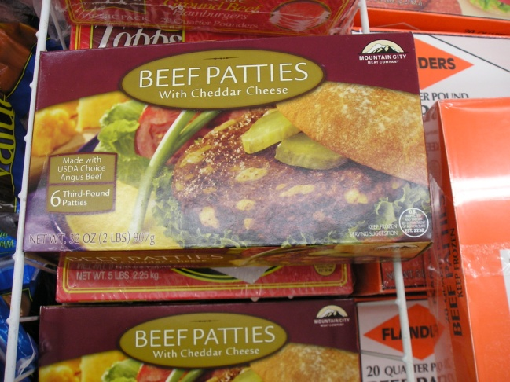
But, food companies must also provide accurate information …
Cooking instructions on 40 brands/types of frozen ground beef patties: varied from 1.5 to 9 minutes per side, for 4 oz patties.

Slide 19
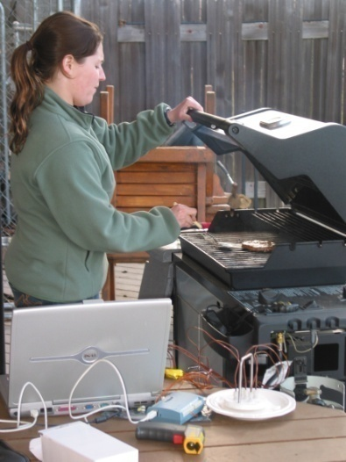
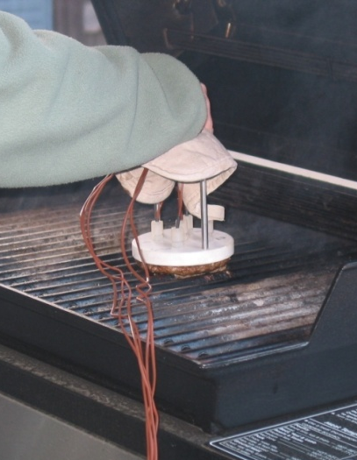
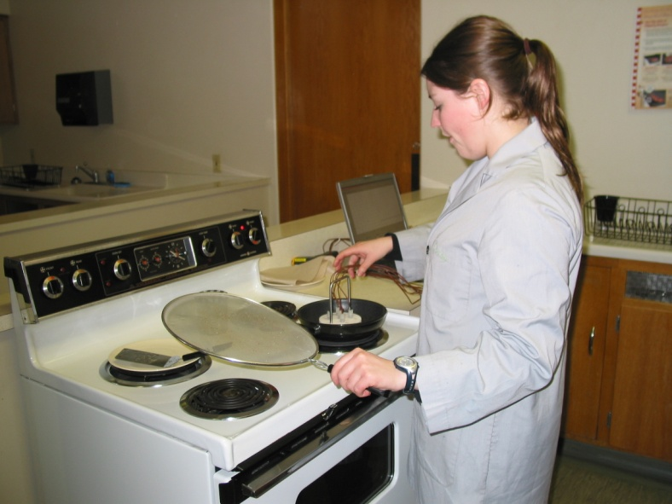
Depending on the setting used, it takes between 7 and 9 minutes (3.5 to 4.5 minutes per side) to cook a 4 oz frozen patty to 160°F

Slide 20
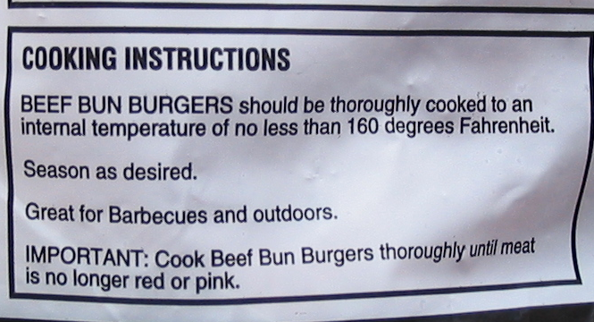
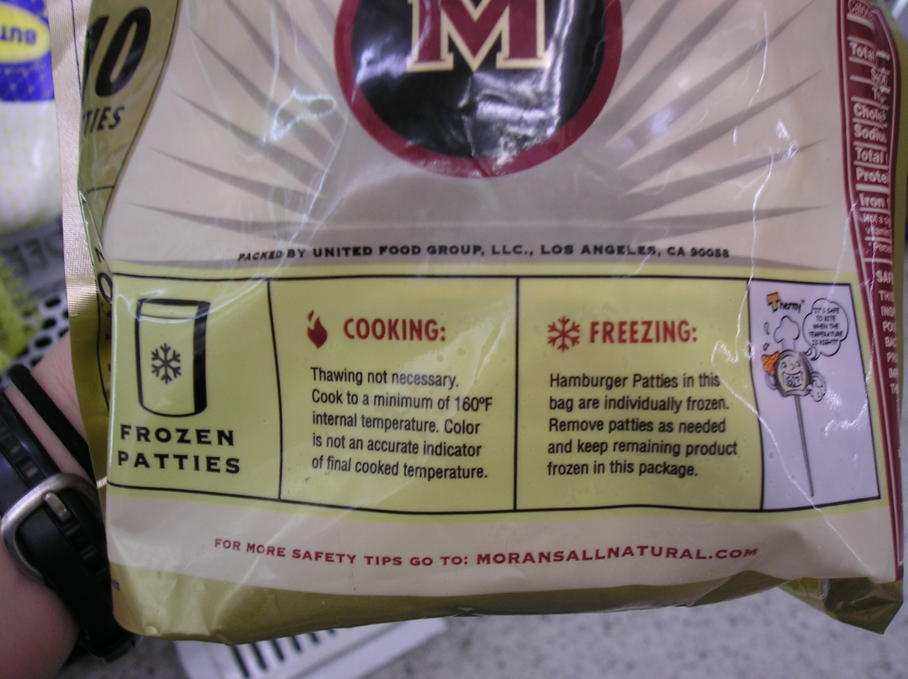
Most mentioned internal temperature of 160ºF, but some had the wrong information about the relationship of color and temperature.

Slide 21
